Slide 1
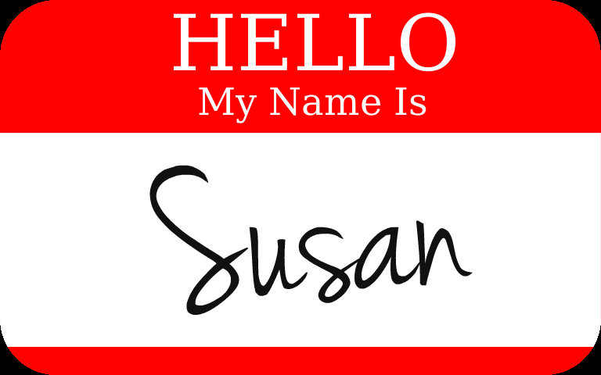
Notes:
Introduce Susan Kuz
Welcome everyone. Good morning!
It's great to have you all here today. I'm Susan Kuz and I'll be your facilitator for the next 2 hours as we move through some fun exercises and get to know each other better.

Slide 2
Using Character Strengths to Boost Job Satisfaction
Agenda
Intro and benefits of Character Strengths
Signature Strengths discovery
Strengths/Job Alignment
Wrap-up
TEXT 204-801-4389 if you have technical problems
Notes:
As you come on the call – please say hi in the chat by typing in one thing that went well today.
We'll cover a lot of ground this evening. Here's what it will look like.
Character Strengths and their benefits - hope you have your strengths assessments with you.
We’ll do 2 activities today: (1) Discovering your signature strengths (2) Aligning a top strength with your job activities
housekeeping:
text if you have any technical problems - my text is 204-801-4389
we will use the chat sparingly, however I will look at it from time to time.
A little about myself:
I have a background in the corporate world prior to working in program design and facilitation. My specialty is in topics related to positive organizational development. I'm passionate about designing programs that help people and organizations change for the better.

Slide 3
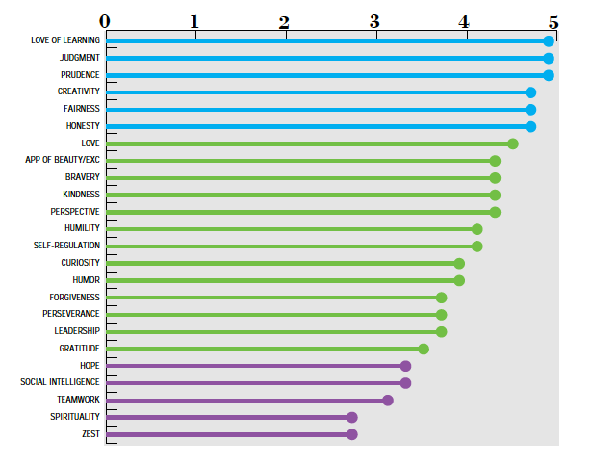
What are Character Strengths?
Signature Strengths
Middle/ Supportive
Lesser
Notes:
You’ve all had a chance to look at the video on the Science of Character Strengths
Character Strengths are the core of Positive Psychology – a scientific focus on what’s right with people.
Types of strengths:
Character strengths are viewed as “who you are,” in other words, they make up part of your core identity.
Here’s a breakdown of several of the types of strengths that you possess:
Types of strengths: Talents – what we do naturally well; Skills – what we train ourselves to do; Interests – our passions; Resources – our external supports; Values – what we internally hold dear
Character Strengths – are the driving force of all of these – they cut across domains and connect with all others.
Signature Strengths: usually at the to – what's most energizing to us – effortless – and essential.
Middle Strengths: supportive of our SS – we use them but not as much
Lesser Strengths: still strengths – use less often, or we may have forgotten about them or are not aware of them.

Slide 4


Strengths Benefits
Boost happiness, guard against depression
Help reduce stress, manage problems
Help accomplish goals, achievements
Improve relationships
Improve health
Increase engagement at work
Increase overall life satisfaction
Help live a life of meaning
Notes:
There are MANY benefits to focusing our strengths in our daily life, our relationships and at work
Research has shown that using our character strengths benefits many areas of our lives
When we use our Strengths they help to:
boost our happiness, guard against depression
increase our engagement at work
reduce stress and manage problems
accomplish goals, and achieve
improve our relationships
improve our health
increase our overall satisfaction with life
help us live a life of meaning
Key: at first focus on using your top strengths more, don’t worry about the ones at the bottom. These are not weaknesses. These strengths will come along for the ride and improve when we use our top strengths more.

Slide 5
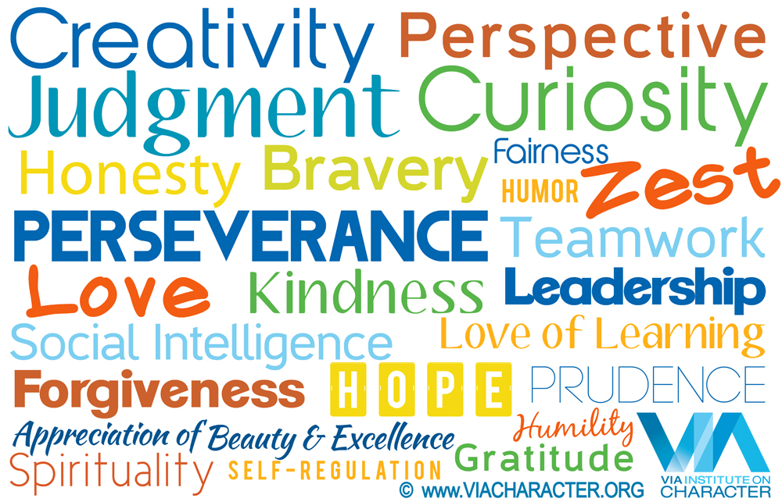
Signature Strengths
  Essential
  Effortless
  Energizing
Notes:
Each of us has a unique way of showing up in the world. We express our unique character naturally and in a way that is energizing to us. We do this with a base blend of our top character strengths or what are referred to as, Signature Strengths.
But typically Signature Strengths are a collection of your top 3 to 7 strengths.
They are natural and effortless to use. Are most energizing. The ones you couldn’t imagine not expressing – as they are an essential part of you.

Slide 6
Signature Strengths Test
Effortless Energizing Essential
Review your top strengths
  Is this strength essential to who I am?
  Does it define me as a person?
OR conversely
  Can you imagine how your life would be if you could not express your strengths of __________ .
Type your 3 Signature Strengths in the chat when done.
Notes:
Take a moment to try to identify 3 your Signature Strengths.
These are the instructions to help you determine if a strengths is a Signature Strengths for you.
If you have any questions please put it in the chat.
When you are done, please type your 3 Signature Strengths in the chat.

Slide 7

Workplace Strengths Benefits
Productivity
Resilience
General well-being
Work satisfaction
Positive emotions
Engagement
Work-as-calling
Meaning
Vitality
Stress (negative and positive)
Counterproductive work behaviors

Slide 8
Strengths & Job Alignment
Purpose - to improve energy at work; discover more meaning and sense of calling at work
Write down THREE job activities that you do most often
(e.g., emailing clients, leading team meetings, making sales calls)
Choose ONE of your Signature Strengths
Identify one way you can use this signature strength in each of your THREE job activities
Share ONE in the Chat (e.g., Creativity: when leading team meetings, I can start each meeting with a new ice-breaker activity)
Notes:
Let’s take a look at how we can tie our signature strengths to our work activities to reap some of these benefits.
The activity will do is sometimes called Job Crafting. If you’ve heard of this before, give me a thumbs up in the reactions.
Here’s how this goes:
Write 3 job activities
Choose ONE Sig Str
Identify 3 ways you can use it, one for each hob activity.
READ example
You’ll have _ minutes to complete this.

Slide 9
Wrap-up
Job alignment sharing
One thing you will do differently as a result of this presentation
Questions: SusanKuz@gmail.com or connect with me on LinkedIn

Slide 10
Signature Strengths
© Susan Kuz 2020
Notes:
Each of us has a unique way of showing up in the world. We express our unique character naturally and in a way that is energizing to us. We do this with a base blend of our top character strengths or what are referred to as, Signature Strengths.
But typically Signature Strengths are a collection of your top 3 to 7 strengths.
The ones you use most often. Are most energizing. The ones you couldn’t imagine not expressing.

Slide 11
Strengths Benefits
Flourishing
Happiness
Positive emotions
Meaning
Positive relationships
Achievement
Healthy behaviors
Resilience/coping
Vitality and passion
Less depression
Less stress/buffer stress
© Susan Kuz 2020
Notes:
Research on Character Strengths has been shown to help us in many ways:
When we use our Strengths they help to:
boost our happiness, guard against depression
increase our engagement at work
reduce stress and manage problems
accomplish goals, and achieve
improve our relationships
improve our health
increase our overall satisfaction with life
help us live a life of meaning

Slide 12
GROUP #1 DISCUSSION INSTRUCTIONS
TAKE TURNS TELLING TELLING YOUR STORY
GO IN ALPHABETICAL ORDER (A TO Z)
ONE PERSON BE THE TIMER
  2 MINUTES PER PERSON
HAVE ONE PERSON BE THE GROUP SPEAKER TO SUMMARIZE YOUR GROUPS BIGGEST TAKE-AWAYS FROM YOUR DISCUSSION

Slide 13
In the CHAT, type any comments you have about this part of our session.
5 minute BREAK

Slide 14
GROUP DISCUSSION #2 INSTRUCTIONS
TAKE TURNS SPEAKING
  READ YOUR LEVEL 1 QUESTION, READ YOUR ANSWER
  GO AROUND UNTIL EVERYONE HAS A CHANCE THEN START AGAIN
GO IN ALPHABETICAL ORDER (A TO Z)
ONE PERSON BE THE TIMER
  ABOUT 1 TO 2 MINUTES PER PERSON
HAVE ONE PERSON BE THE GROUP SPEAKER TO SUMMARIZE YOUR GROUPS BIGGEST TAKE-AWAYS FROM YOUR DISCUSSION

Slide 15
SET 2 – forgot your questions?
WHAT IS THE GREATEST ACCOMPLISHMENT IN YOUR LIFE ?
WHAT DO YOU MOST VALUE IN A FRIENDSHIP?
WHAT IS YOUR MOST TREASURED MEMORY?
HOW DO YOU FEEL ABOUT YOUR RELATIONSHIP WITH YOUR MOTHER?
HOW CLOSE AND WARM IS YOUR FAMILY? DO YOU FEEL YOUR CHILDHOOD WAS HAPPIER THAN MOST OTHER PEOPLE’S?

Slide 16
Wrap-up
In the chat, type in ONE thing you will do differently after taking part in this seminar.
“Authenticity is the daily practice of letting go of who we think we’re supposed to be and embracing who we are. Choosing authenticity means cultivating the courage to be imperfect.” - Brené Brown
Questions, Connect: s.kuz@uwinnipeg.ca
Notes:
Tips:
As you can see, as we open up to being more vulnerable we become more human. It’s difficult yes, but it’s the only wat to be real – to be ourselves.
Use your Signature Strengths daily

Slide 17
Questions
Email s.kuz@uwinnipeg.ca

Slide 18
How was it?
How did it feel to give your introduction?
Did you learn anything new about yourself? What?
Did you create a clearer self-definition in this process?
Multiple stories? How did you select one?
© Being Pukka 2018

Slide 19
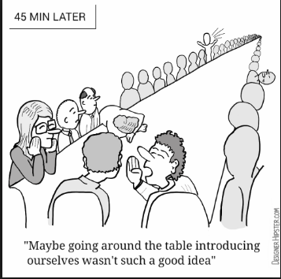
Hello my name is…
Engage
Motivate
Share understanding
Change culture
© Being Pukka 2018
Notes:
How are we doing now?
Hopefully we know each other just a little bit more than we did when we walked into the room.
And hopefully with this new tool we can avoid putting people to sleep during vanilla, predictable introductions.
This process can be used anywhere you have a group or team come together. It is especially useful in corporate settings with work teams or project teams.
Helps us understand each other by building honesty and openness.
And to feel heard and seen in a world where that is djsfkljdslfj

Slide 20
QUOTE
LOGO, WEBSITE, EMAIL, CONTACT INFO

